Slide 1
CARAVAN INSURANCE PRESENTATION
Mansi Goyal-6709502
Neha Jogula-6706944
Eashwar Thyagarajan-6713922
Joseph James- 6713109

Slide 2
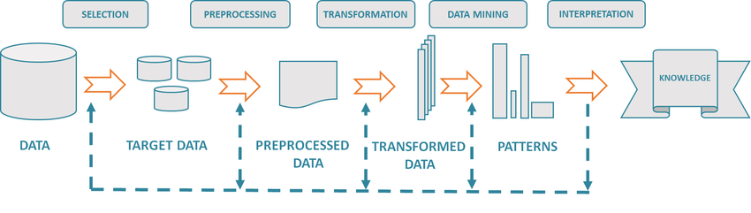
Project analysis slide 11
Executive Summary
The key function of this data analytics task is to anticipate if a consumer will be buying a caravan home policy in order to characterize a typical caravan insurance buyer's profile. Software tools like IBM SPSS Modeler 18.2.1 and Microsoft Excel are used for modelling. The methodology used here is KDD as shown in figure 1 (fig .1) and CRISP-DM.
In our investigation we found that caravan insurance buyer show a few characteristics which are reliable with our common sense. Instinctively, a caravan buyer might claim a caravan and a caravan proprietor might possess a car to drag his/her caravan. We’ve also observed that people who buy a fire policy tend to buy a caravan insurance policy because there are many major risks of fire in a caravan as the oil used for cooking in a caravan is highly flammable.
Based on our results, we recommend that the organization needs to conduct various joint marketing events in order to increase the awareness of risk. Furthermore, the insurance business might provide a combined package of car, fire, and caravan insurance to potential consumers in gaining a better understanding of client characteristics and developing marketing strategies that are in line with the findings.
Fig.1 The KDD process road map

Slide 3
Literature review
https://link.springer.com/chapter/10.1007/978-1-4471-0351-6_12​
In this paper KDD that is knowledge discovery in the database has been discussed extensively, explaining all the significant stages of the process. The methodology is provided in the form of a road map, with the stages highlighted and explanations of how careful preparation can lead to a successful and well-managed project.​
https://www.slideshare.net/muthukum/caravan-insurance-data-mining-statistical-analysis​
In this report the initial factors have been thoroughly understood and classified to reflect properties of socio-demographic, education, lifestyle, income, car, and insurance interests as they relate to product type. The descriptive statistics of the target variables in the data set were then used to analyze the logically predicted significant factors using IBM SPSS.
Market Assumption
It is necessary to determine the cost of insurance in order to calculate the firm's profit. The cost of the caravan insurance assumed in this scenario is £107.
Source: https://www.comparethemarket.com/caravan-insurance/?AFFCLIE=EY12
Furthermore, we assume that the profit from selling a single insurance policy is 20% of the cost, or £21.4 in a single transaction (true positives will help in detecting the same). Due to the missed opportunity, the company will lose money (false negatives).

Slide 4
Project analysis slide 2
Data sourcing &description
The dataset we used consisted of 9,822 customer records and includes sociodemographic information about the area where a customer lives(43 attributes) as well as information about the customer's product ownership(42 attributes).
The default field names, such as MAANTHUI Number of houses and PBRAND Contribution fire policies, have been modified to new field names such as no_houses and cont_fire.
The Dataset was supplied by a Dutch Data Mining Company Sentinel Machine research. The dataset is divided into 5822 training records and 4000 test records along with 86 attributes or fields.
The training data has been trained in such a way that the model gives the best accuracy and sensitivity. The same model is later used on the test data to create an accurate customer profile of a caravan insurance buyer.
The given data can be classified into various genres such as Nominal, categorical, continuous, etc.
Field 86 has been considered as the target field (dependent variable) which is used to predict the people who will buy a caravan and the rest 85 fields are considered as the input fields and act as the independent variables.

Slide 5
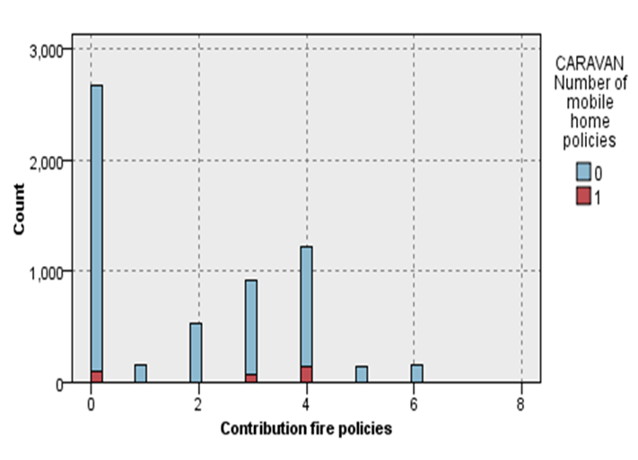
Project analysis slide 2
Data visualization
The Data Audit node assists in determining the number of legitimate records as well as basic statistics. Basic statistics shown when we run this node are sample graphs, uniqueness, std deviation, mean, maximum and minimum of the data, and so on.
The given data audit graph represents the Contribution fire policies (fig.2) feature from the product ownership category.
We can understand from the graph that people who have acquired fire policies have also bought caravan mobile home policies as the oil used for cooking in a caravan is highly flammable and there are numerous serious fire risks.
Buyers who contribute f0 fire policies count roughly 110, whereas those who contribute f100-f499 fire policies number around 219 people. Therefore, this could be the reason most potential caravan insurance buyers also have a fire insurance policy.
Fig.2. Contribution fire policies graph.

Slide 6
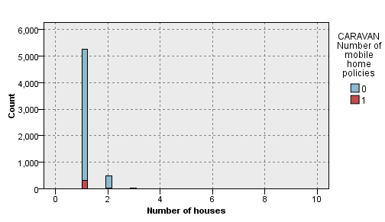
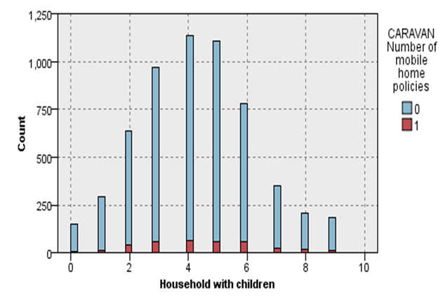
Project analysis slide 2
The given data audit graph represents the Number of houses and household with children from the socio-demographic category.
From the graph (Fig.3), we can identify that some of the people who have bought 1 house with a total count of around 300 have also made their investment in caravan insurance.
From the graph (fig.4), we can visualize that household with children ranging between 2-6 is more inclined towards buying caravan insurance.
In comparison, we can observe that the household with children might be considered as a good factor rather than the number of houses in order to predict who will buy the caravan insurance.
But these are the already available average data based on the respective zip codes and hence cannot be considered as a factor to determine whether people under these groups will buy a caravan.
Fig.3. number of houses graph
Fig.4. household with children

Slide 7
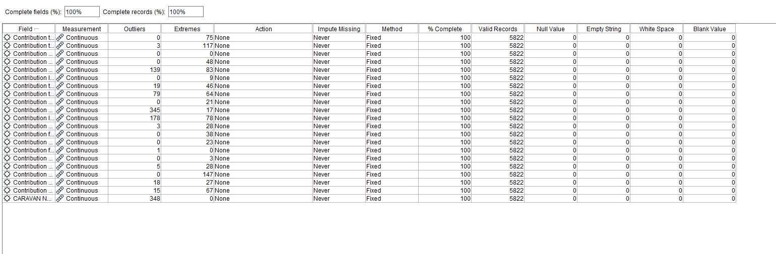
Project analysis slide 11
Data Cleansing
From the dataset, we can illustrate the following:-
Null Values: There are no null values in either the training or test data.
Repeated Values: The 5th and 32nd customer subtypes are the same, and they are referred to as “Mixed Seniors”.
Outlier Detection: Very few outliers are displayed because the data is meaningful for our interpretation. As a result, these little outliers are not an issue in our prediction because they enrich our learning. This is shown in figure 5 (Fig.5) below using data audit.
Fig. 5 Data Cleansing

Slide 8
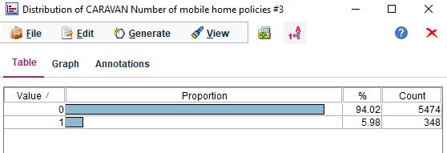
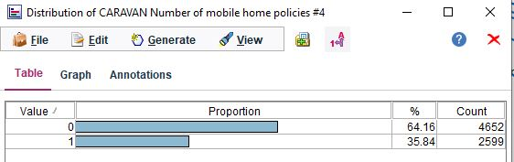
Project analysis slide 2
Data Balancing
Duplicating and subsequently discarding records based on the conditions is how balancing is done. Records that are not subject to any conditions are always passed through. The original sequence of your data is lost in downstream processes because this procedure operates by duplicating and/or discarding records.
When the distribution node was run on the raw data only 5% of people the data were buying caravan insurance which is very low and not efficient because the model is tending towards the people who don’t buy the insurance as shown in figure 6 (Fig. 6).
So, to balance the data for accurate analysis we tried target boosting and target reduction the output was not as expected and efficient. So, hybrid balancing method has been used to balance out data to give a necessary output. The main advantage of this is we get both benefits of education and boosting.
The target is boosted with a factor of 7.5 and reduced with a factor of
0.85 which gives us 64% and 35% distribution as shown in Fig.7.
Fig. 6
Fig. 7

Slide 9
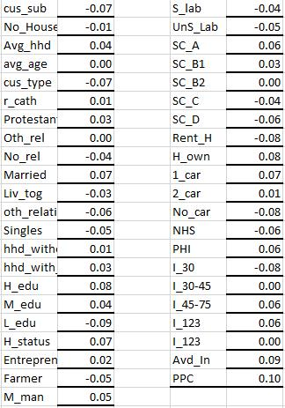
Project analysis slide 2
Feature Selection
Correlation with Target
Correlation is a bivariate analysis that measures the strength of association between two variables and the direction of the relationship. In this analysis, we adopted the correlation technique to determine the most important features with the target field as shown in figure 8 (fig.8).
If the correlation is close to one, the dependent variable will move in the same direction as the independent variable. In the event of -1.0, the exact opposite will occur, whilst a number near zero indicates that there is no association between the variables.
All socio-demographic statistics are averages of customers linked by ZIP code. As a result, they've been eliminated because they can't provide us with an individual customer profile and hence aren't relevant to our prediction. All of these features have a correlation value of approximately zero or a negative value.
Fig. 8

Slide 10
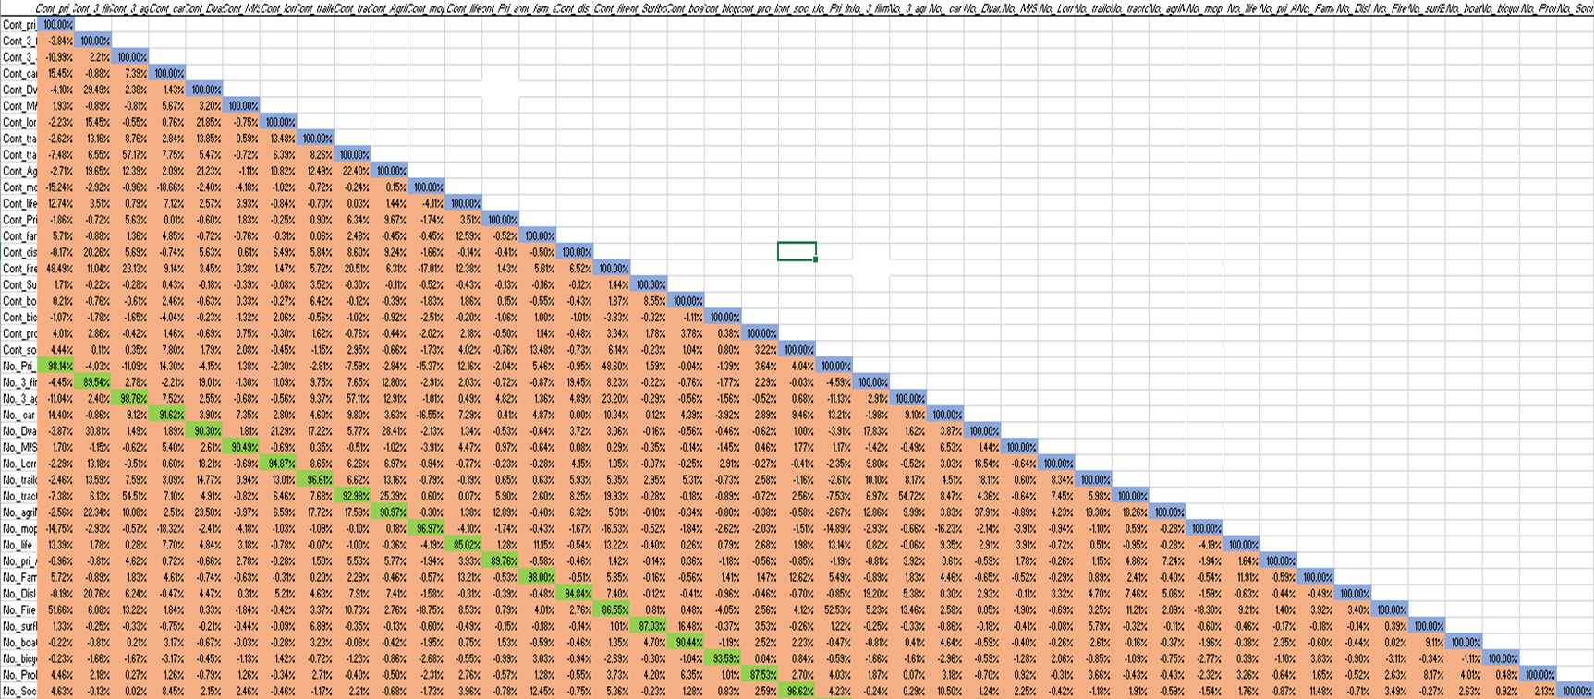
Project analysis slide 3
Multicollinearity
The next strategy for reducing undesirable features is multicollinearity, which means that the variables being compared are closely connected. As this issue could lead to a misleading model, so higher multicollinear features are eliminated at this stage.
The figure (Fig.9) displays the heat map, which exhibits the higher multicollinear characteristics between the last 42 features. Microsoft Excel has been used to check the collinearity between the features as shown in the figure.
In this step all the No. of policies fields such as no. of fire policies, no. of 3rd party insurance policies are filtered out because they have high collinearity with all the contribution fields.
Fig. 9. Heat map

Slide 11
Project analysis slide 4
Model Selection
The project's major goal is to find a suitable model once the dataset has been trained. After producing a confusion matrix from the data set, the discovered models are assessed for accuracy, sensitivity, specificity, and precision.
Every model's major goal is to reduce the erroneous negative value. It's because they're the types of consumers that are most inclined to acquire caravan insurance, yet the model labels them as non-customers. Customers will lose business as a result of this.
Each pre-defined machine learning model gives various results based on the unique algorithms used.
The following machine learning models are put to the test in order to predict how many people will acquire caravan insurance.
C5.0
CHAID
Neural network
Random tree

Slide 12
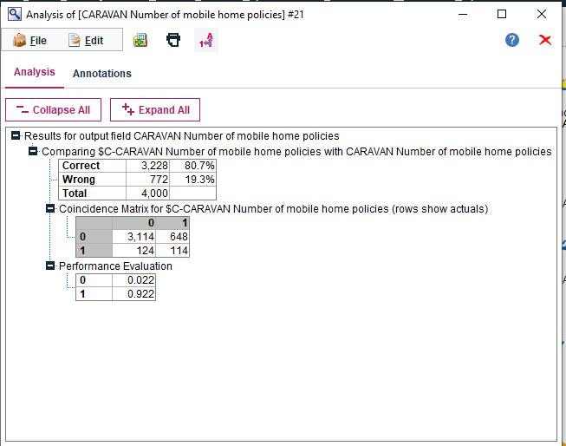
Project analysis slide 5
C5.0
A C5.0 model divides the sample according to the field that delivers the most information gain. This node builds a decision tree or a rule set using the C5.0 algorithm.
The given figure 10 (Fig.10) represents the confusion matrix of the C5.0 model.
The test data accuracy is above 80% and performance evaluation for 1’s is above 0.9.
We may deduce from the confusion matrix that 114 (True positives) persons are likely to be interested in purchasing a caravan house insurance policy, and hence a significant amount of time and money can be spent courting these potential clients.
We may also deduce from the confusion matrix that 3114 (True negatives) people might not have an interest in caravan policies and thus the resources don’t get misdirected.
Our models incorrectly anticipate that 648 people would be interested in purchasing a mobile home insurance policy.
Fig. 10

Slide 13
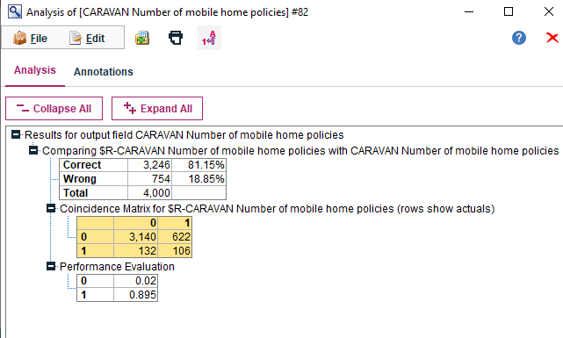
Project analysis slide 6
CHAID
CHAID (Chi-squared Automatic Interaction Detection) is a classification approach for constructing decision trees that uses chi-square statistics to find optimal splits.
Given figure11 (fig. 11) represents the confusion matrix of the CHAID model.
The test data accuracy is above 81% and performance evaluation for 1’s is above 0.89.
We may deduce from the confusion matrix that 106 (True positives) persons are likely to be interested in purchasing a caravan house insurance policy, and hence a significant amount of time and money can be spent courting these potential clients.
We may also deduce from the confusion matrix that 3140 (True negatives) people might not have an interest in caravan policies and thus resources don’t get misdirected.
Our models incorrectly anticipate that 622 people would be interested in purchasing a mobile home insurance policy.
Fig. 11

Slide 14
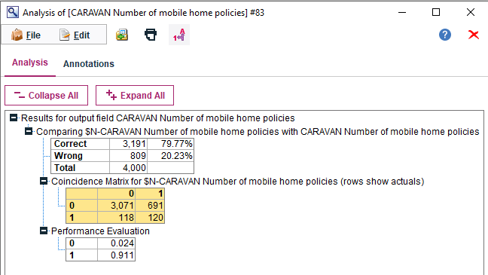
Project analysis slide 7
Neural network
A neural network is a simplified representation of how the human brain processes data. It operates by mimicking many interconnected processing units that look like abstract neurons.
The given figure 12 (Fig. 12) shows the confusion matrix of the Neural network model.
The test data accuracy is above 79% and performance evaluation for 1’s is above 0.9.
We may deduce from the confusion matrix that 120(True positives) persons are likely to be interested in purchasing a caravan house insurance policy, and hence a significant amount of time and money can be spent courting these potential clients.
We may also deduce from the confusion matrix that 3071(True negatives) people might not have an interest in caravan policies and thus the resources don’t get misdirected.
Our models incorrectly anticipate that 691 people would be interested in purchasing a mobile home insurance policy.
Fig. 12

Slide 15
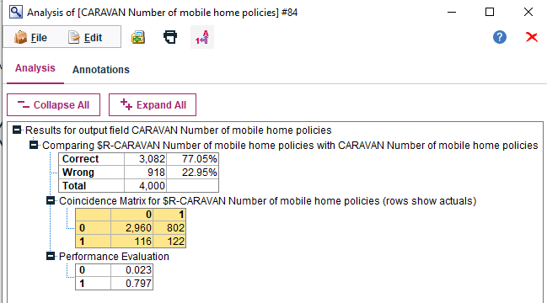
Project analysis slide 8
Random Trees
Depending on the Classification and Regression Tree methodology, the Random Trees node is a tree-based classification and prediction strategy.
The given figure 13 (Fig.13) shows the confusion matrix of the Random trees model.
The test data accuracy is above 77% and performance evaluation for 1’s is above 0.7.
We may deduce from the confusion matrix that 122 (True positives) persons are likely to be interested in purchasing a caravan house insurance policy, and hence a significant amount of time and money can be spent courting these potential clients.
We may also deduce from the confusion matrix that 2960 (True negatives) people might not have an interest in caravan policies and thus the resources don’t get misdirected.
Our models incorrectly anticipate that 802 people would be interested in purchasing a mobile home insurance policy. So, we don't have to waste time or money on them.
Fig. 13

Slide 16
Project analysis slide 10
Comparison and Results
Appendix 2 shows the result of all the models we ran on the test data, with relevant feature selection. We have jotted down specificity, sensitivity, precision, and accuracy obtained from each model to compare and find an ideal final model for a customer profile. We choose to run models such as C5.0, neural, CHAID, logistic regression, random forest, and random trees.
From the comparison we can clearly observe that CHAID and Random Forest have the highest test accuracy, but their sensitivity is the least among all the models. We know that sensitivity or true recall rate is the correctness of a prediction made in a model. (The number of valid positive predictions divided by the total number of positive samples yields sensitivity.)
Random trees have the highest sensitivity but when it comes to accuracy and specificity, it has the lowest among all the models so even this model is omitted.
Bayesian has the highest accuracy, but it has the lowest sensitivity among all the models.
The Results of C5.0, Logistic regression, and Neural Network have similar characteristics such as sensitivity and test data accuracy but the C5.0 model gives us the best specificity. This algorithm provides everyone in management a decision tree that they can comprehend, which can help them keep to the same plan.
From these analyses, it is concluded that C5.0 is the best model for our customer profile analysis.

Slide 17
Customer Evaluation
The following fields have been identified as the most important after running the C5.0:
Contribution car policies
Contribution family accidents insurance policies
Contribution fire policies
Contribution boat policies
Contribution third party insurance (agriculture)
Contribution disability insurance policies
Contribution social security insurance policies
Contribution life insurance
Contribution trailer policies
Contribution bicycle policies

Slide 18
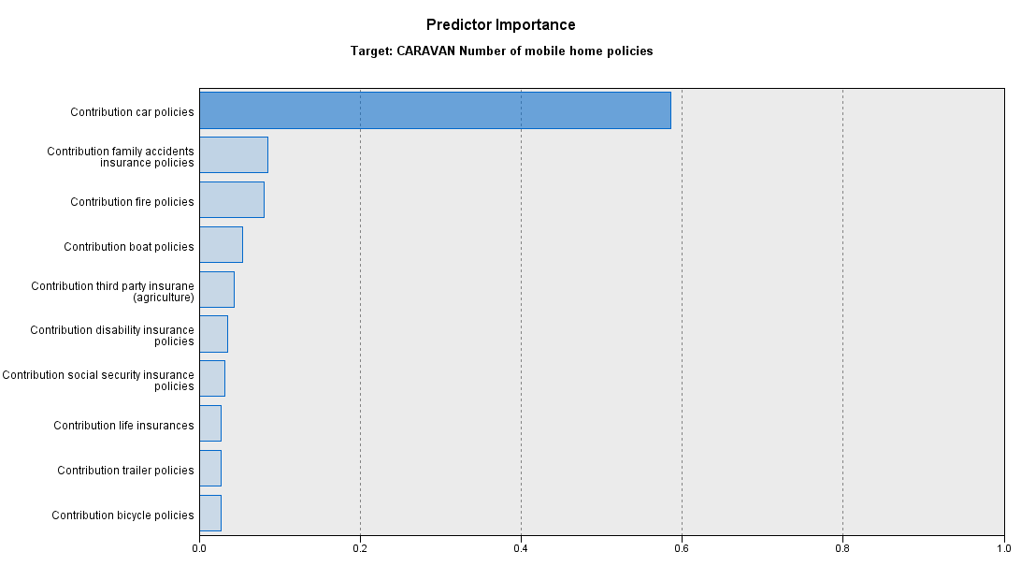
After picking the proper model and testing it for sensitivity, accuracy, precision, specificity, and error rate, the profile of a typical policyholder is determined using decision tree modelling. A typical caravan insurance customer is one who has paid for the vehicle, fire, and third-party private insurance.
Through the predictor importance graph, it can be observed that Contribution car policies are the most important field with almost 0.59 importance among all the features.
We can observe that the contribution to bicycle policies is the least important feature among all these fields.
Fig. 14. C5.0 Prediction Importance

Slide 19
Customer Profile
The report's main goal is to identify the customers of caravan insurance. To summarise, according to the decision tree visualization in Figure 15, a consumer of a caravan insurance policy is:
Who contributes f0 towards boat policies
Who contributes f500-f9999 towards car policies
Who contributes f500-f999 towards disability policies
Who contributes f0 towards trailer policies
Who contributes f1-f49 towards third party agriculture policies
Who contributes f0 towards bicycle policies
Who contributes f50-f999 towards the fire insurance
Who contributes f1-f49 towards family accident insurance
Who contributes f1-f49 towards the social security insurance policy
Who contributes f1-f49 towards life insurance policies

Slide 20
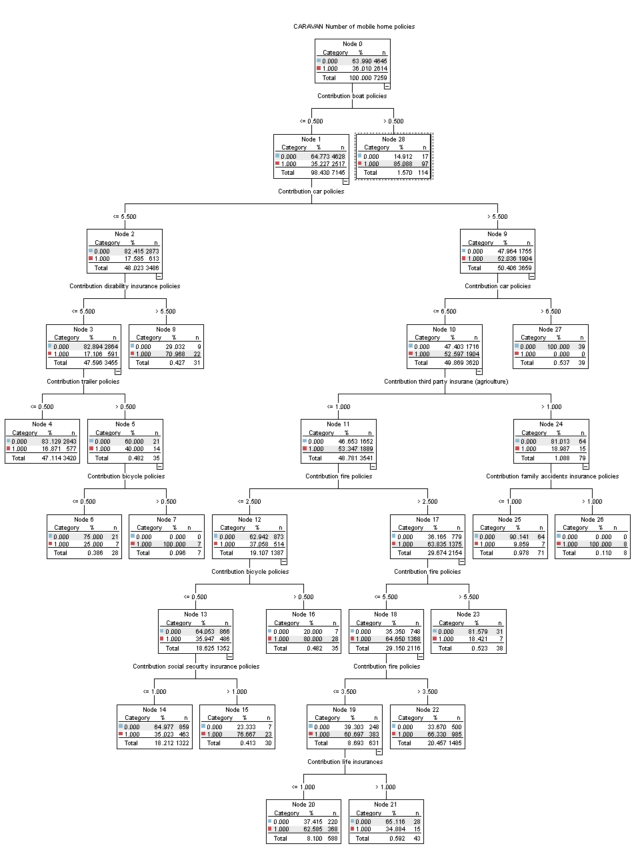
Fig.15 Decision tree for customer profile prediction

Slide 21
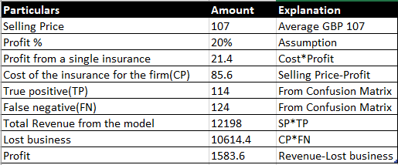
Business Prospective
Based on the assumptions made previously, the company is profitable with this approach. With the final decision tree model, the company makes a profit of 1583.6 pounds.

Slide 22
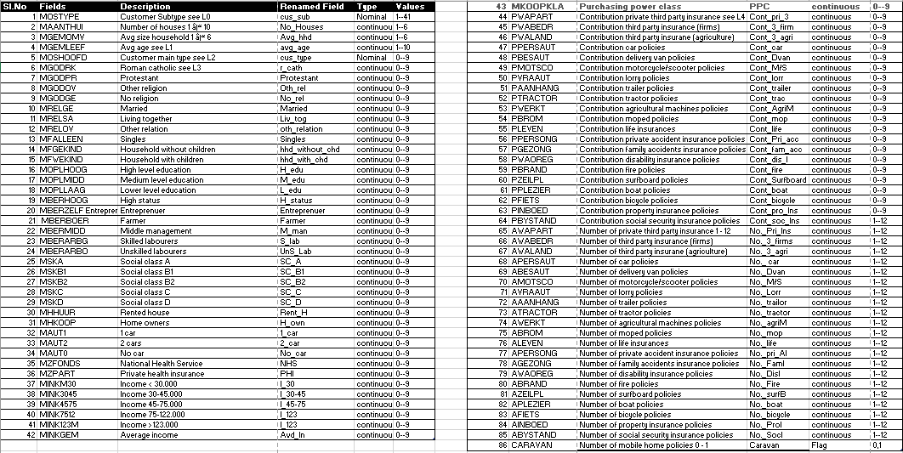
Appendix 1

Slide 23
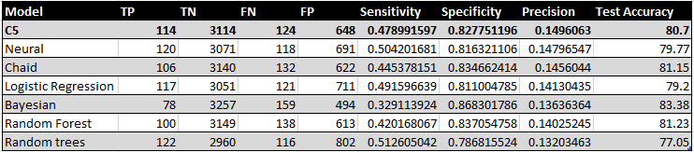
Appendix-2
(Model Comparison)

Slide 24
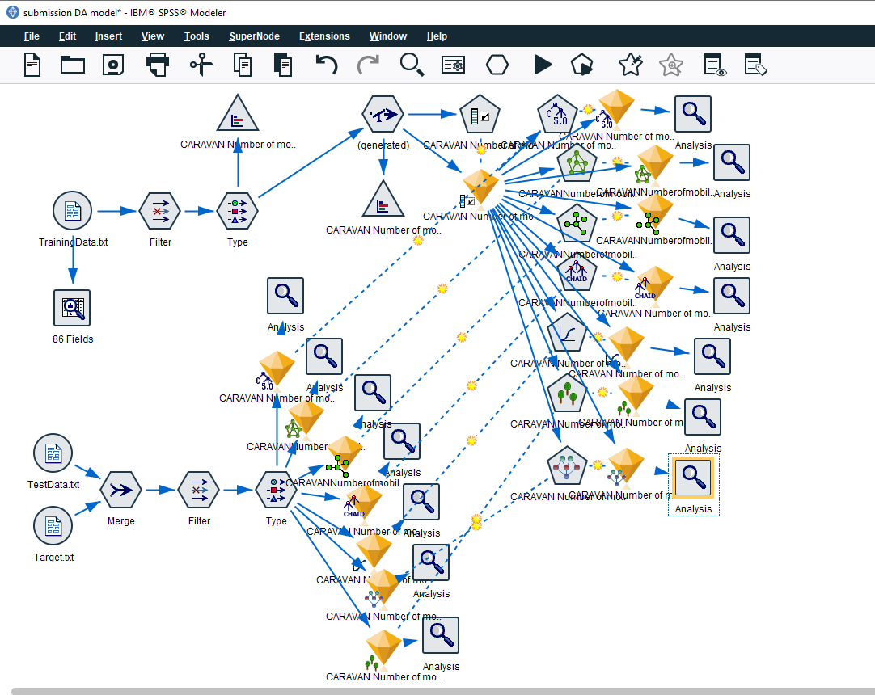
Appendix 3
(Final model)

Slide 25
Thank You

